Slide 1

Objectify (Object Detector)
By: Kyra Behl

Slide 2

Table of Contents:

Slide 3



Acknowledgements

Slide 4


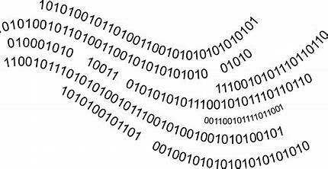
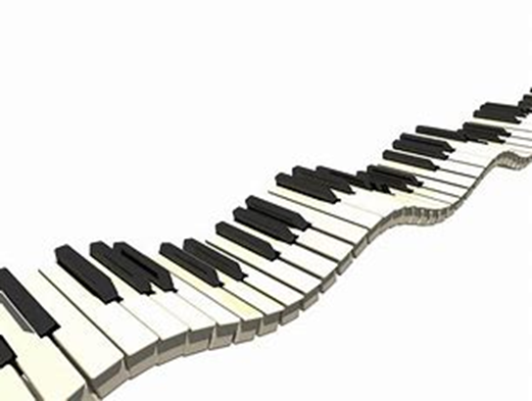

About me:
My name is Kyra Behl! I am fourteen years old and have just finished Grade 8 and transitioning to Grade 9 in the coming academic year. When I'm not coding, you can find me on the piano or the golf course. My other hobbies beside coding are sketching and writing books including book reviews! I am a published author on Amazon and have had some of my books sold in local bookstores. In total, I have published 3+ books and my new novel is in the midst of being published.

Slide 5

Internship Journey with Clevered
So far, I'm enjoying the internship and have learnt so much, I feel more confident in coding in python and have a clearer understanding of different AI models which have already been made. We finally now have a chance to bring out chosen project to life and are given a month to code it, I'm really looking forward and excited for this milestone in my journey!
I am quite keen to work with Mr. Ken and the Clevered Mentors. Along with that, I'm grateful to receive such opportunity to do so.

Slide 6
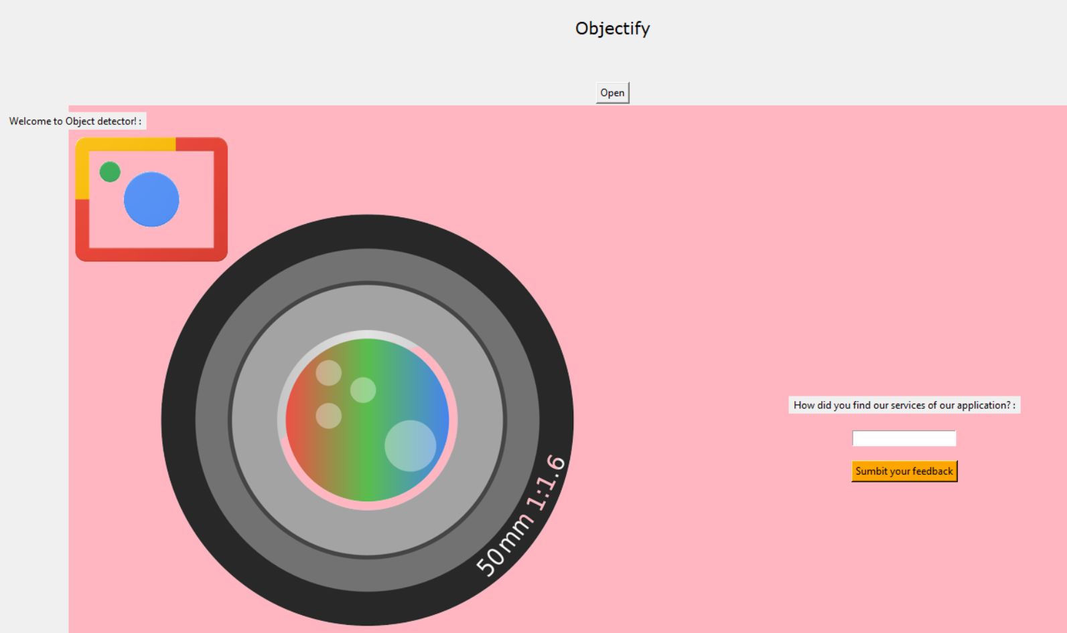
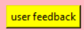
About my app
•App’s Introduction:
•My app A.K.A Objectify is a fully functioning machine which can scan objects around it through pictures and even gives a speech output of their names. The purpose of my app is to help visually impaired people or anyone with some sort of disability!
In a way, I want to create my app as a lifeline for those who find difficulties in doing simple everyday tasks.

Slide 7
How do I use the App?

Slide 8
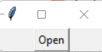
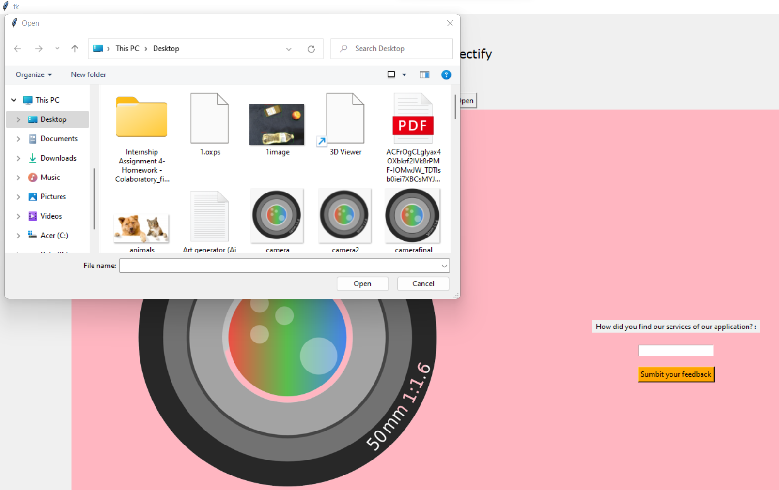
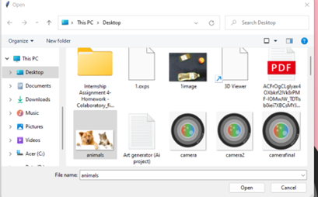
Open Button function
Once the button (open button) pops up, you press on it and enter the name of your file/pic you want to upload and then for the next step go to the next slide!
Lastly, if you accidently upload the wrong file you can re-upload the right one :)

Slide 9
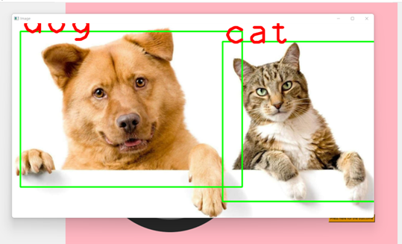

Click the button for output function
The button
The output
For this function, after uploading your file you are supposed to press this button to confirm and receive your output. After your output is given, you will receive a speech output as well to your device!
My app is really easy to use and has a minimal number of functions to reduce the complicity and help you get to the final outcome!
The logo

Slide 10
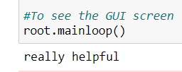
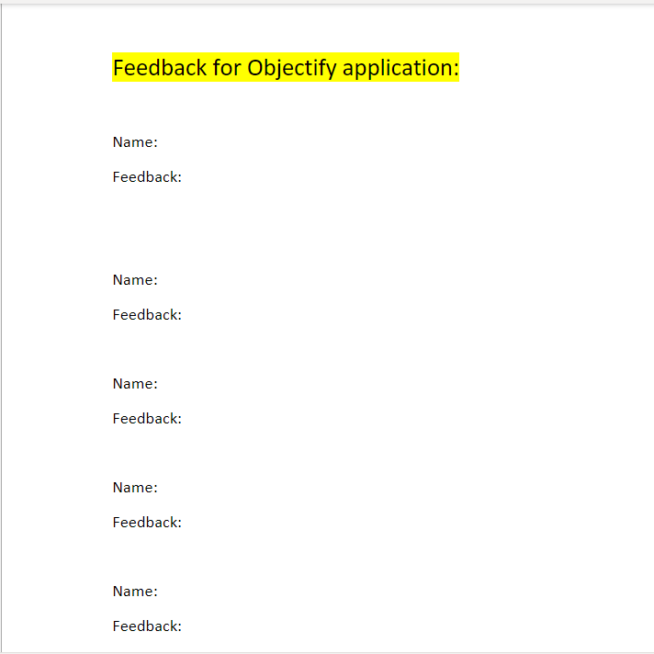
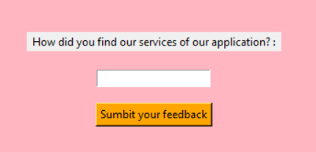
Submit your feedback button!
Here you will be able to submit your feedback about the app and give a clear opinion about your experience using the application! All you must do is press submit and the work will be done.
Along with that, a link will open where you can give your feedback straight to the programmer(me) to review and respond back!

Slide 11

Contact details:
If you have any concerns regarding how the application functions or suggestions, then please contact the following email:
tarana-b@hotmail.com

Slide 12
Thank you for going through my presentation!
By: Kyra Behl

